Slide 1
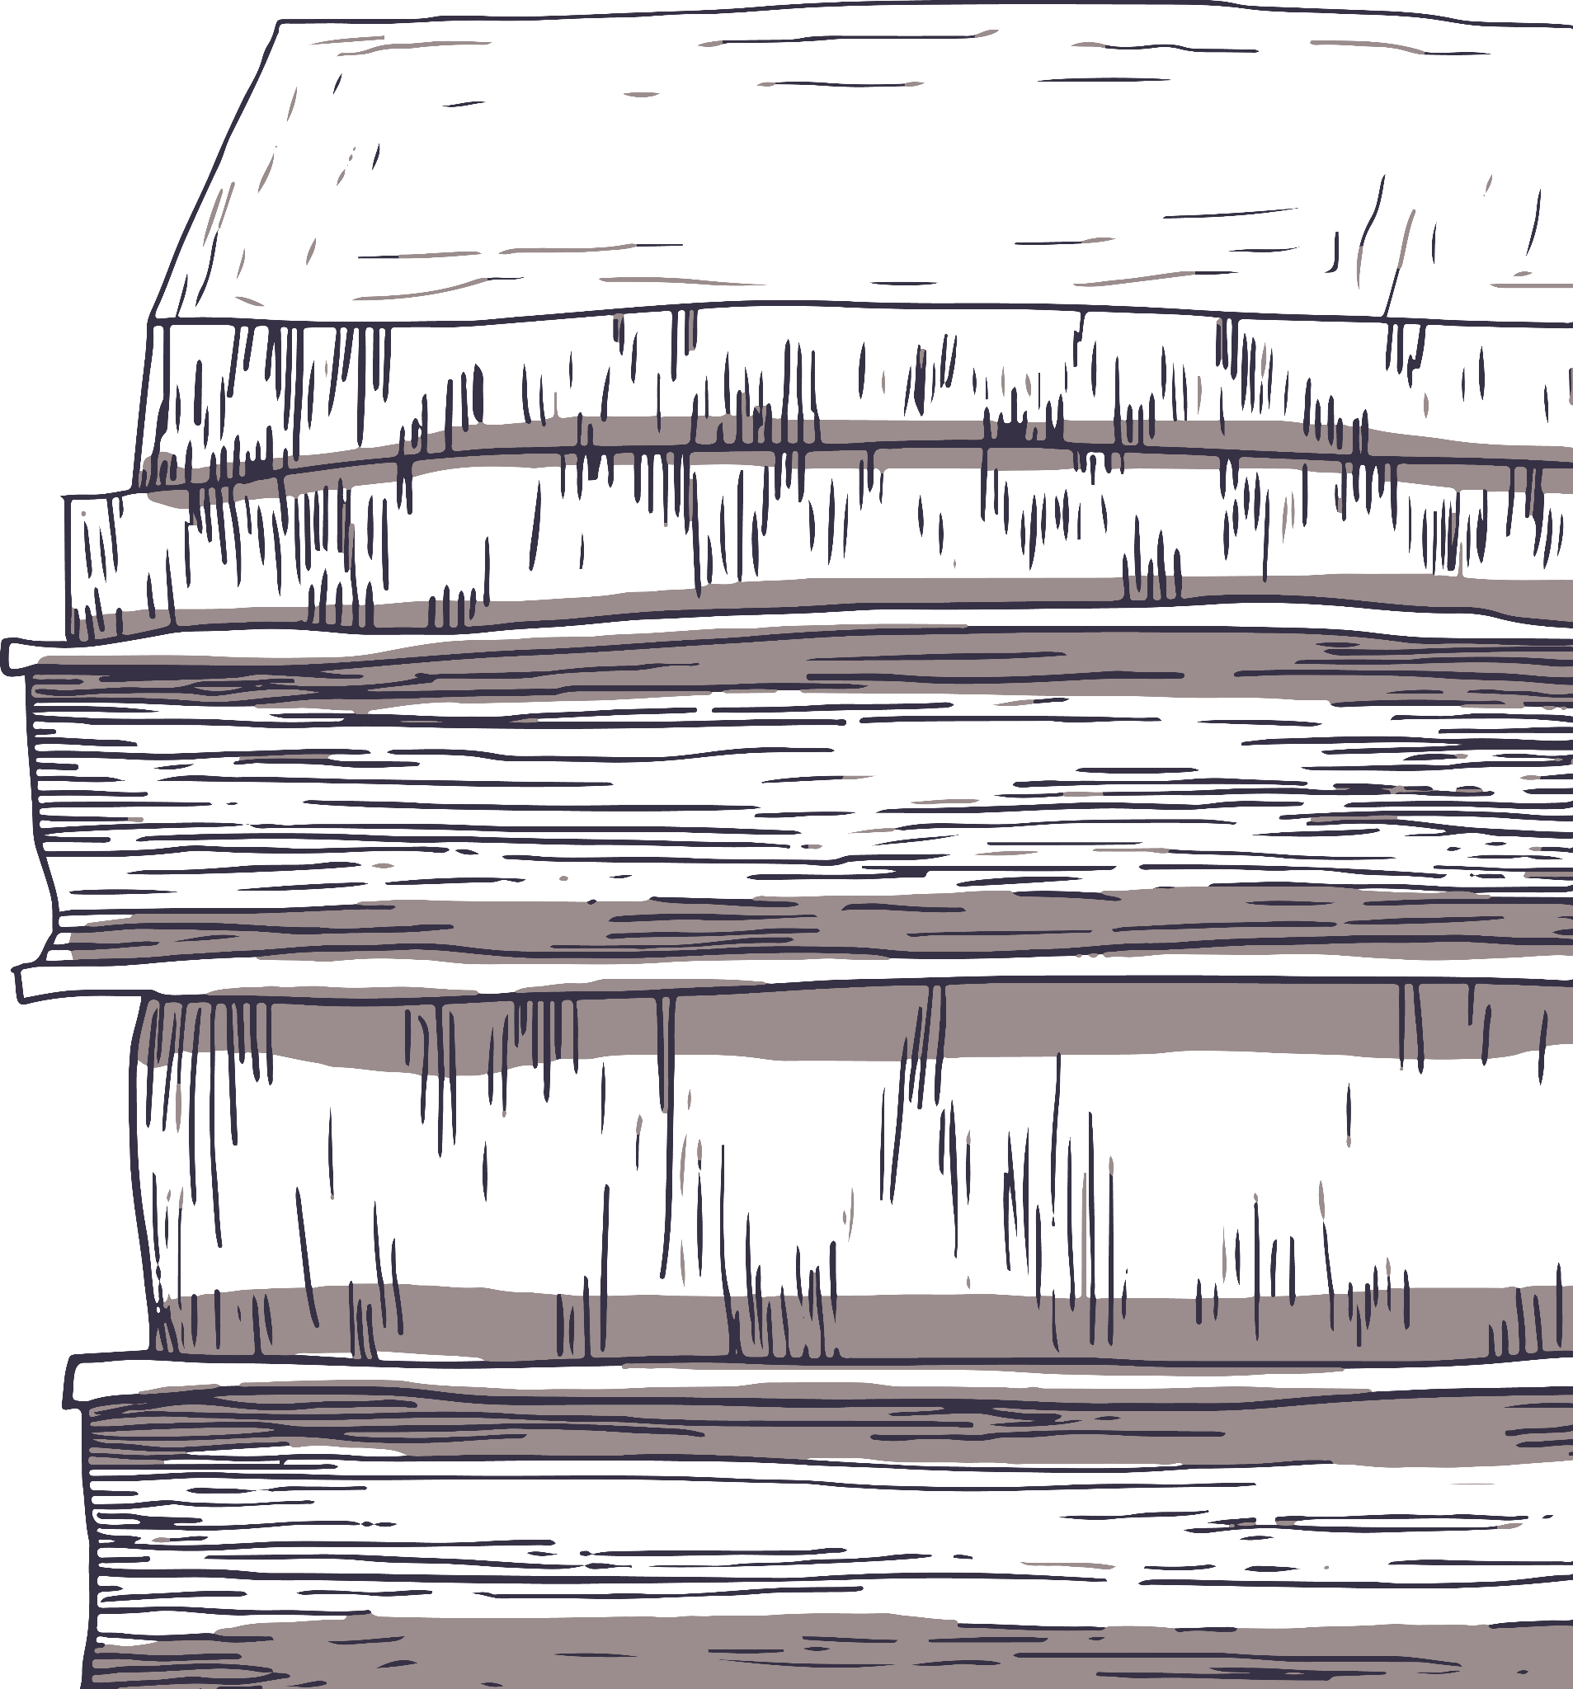
Thesis Defense: Epic Poetry, History and Criticism
Here is where your presentation begins

Slide 2
Contents of this template
You can delete this slide when you’re done editing the presentation
Fonts | To view this template correctly in PowerPoint, download and install the fonts we used
Used and alternative resources | An assortment of graphic resources that are suitable for use in this presentation
Thanks slide | You must keep it so that proper credits for our design are given
Colors | All the colors used in this presentation
Icons and infographic resources | These can be used in the template, and their size and color can be edited
Editable presentation theme | You can edit the master slides easily. For more info, click here
For more info:
SLIDESGO | BLOG | FAQs
You can visit our sister projects:
FREEPIK | FLATICON | STORYSET | WEPIK | VIDEVO

Slide 3
Table of contents
01
02
03
04
05
06
Statement
You can describe the topic of the section here
Hypothesis
You can describe the topic of the section here
Objectives
You can describe the topic of the section here
Methodology
You can describe the topic of the section here
Analysis
You can describe the topic of the section here
Conclusions
You can describe the topic of the section here

Slide 4
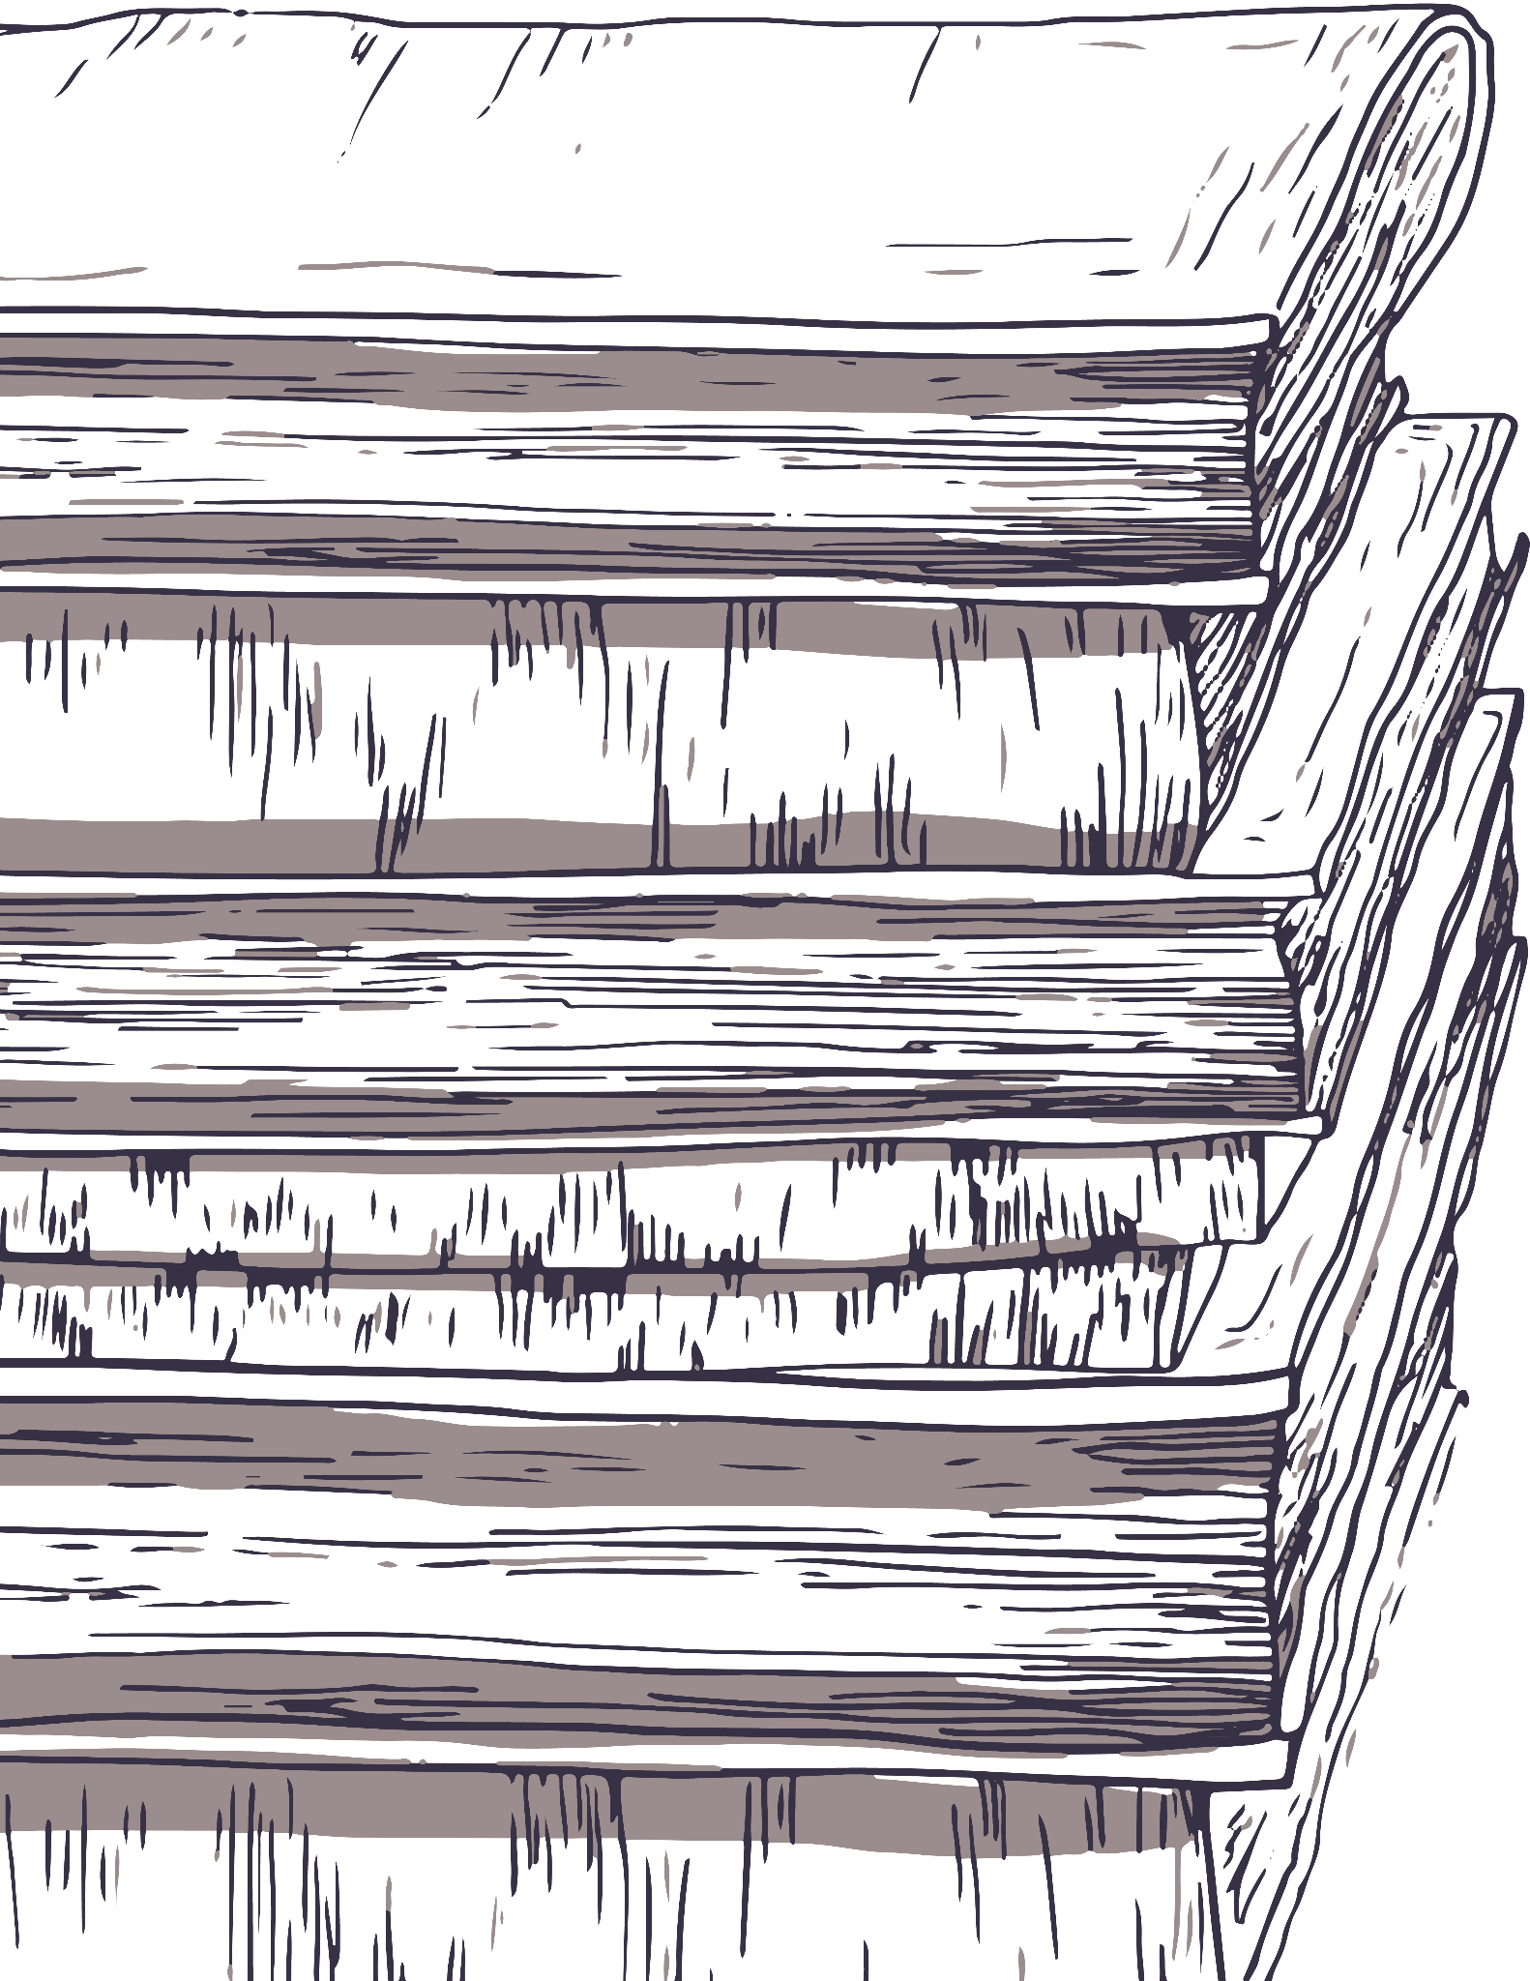
01
Statement
You can describe the topic of the section here

Slide 5
Purpose statement
What about Mercury?
Mercury is the closest planet to the Sun and the smallest one in the Solar System
What about Venus?
Venus has a beautiful name and is the second planet from the Sun
What about Jupiter?
Jupiter is a gas giant and the biggest planet in the Solar System

Slide 6
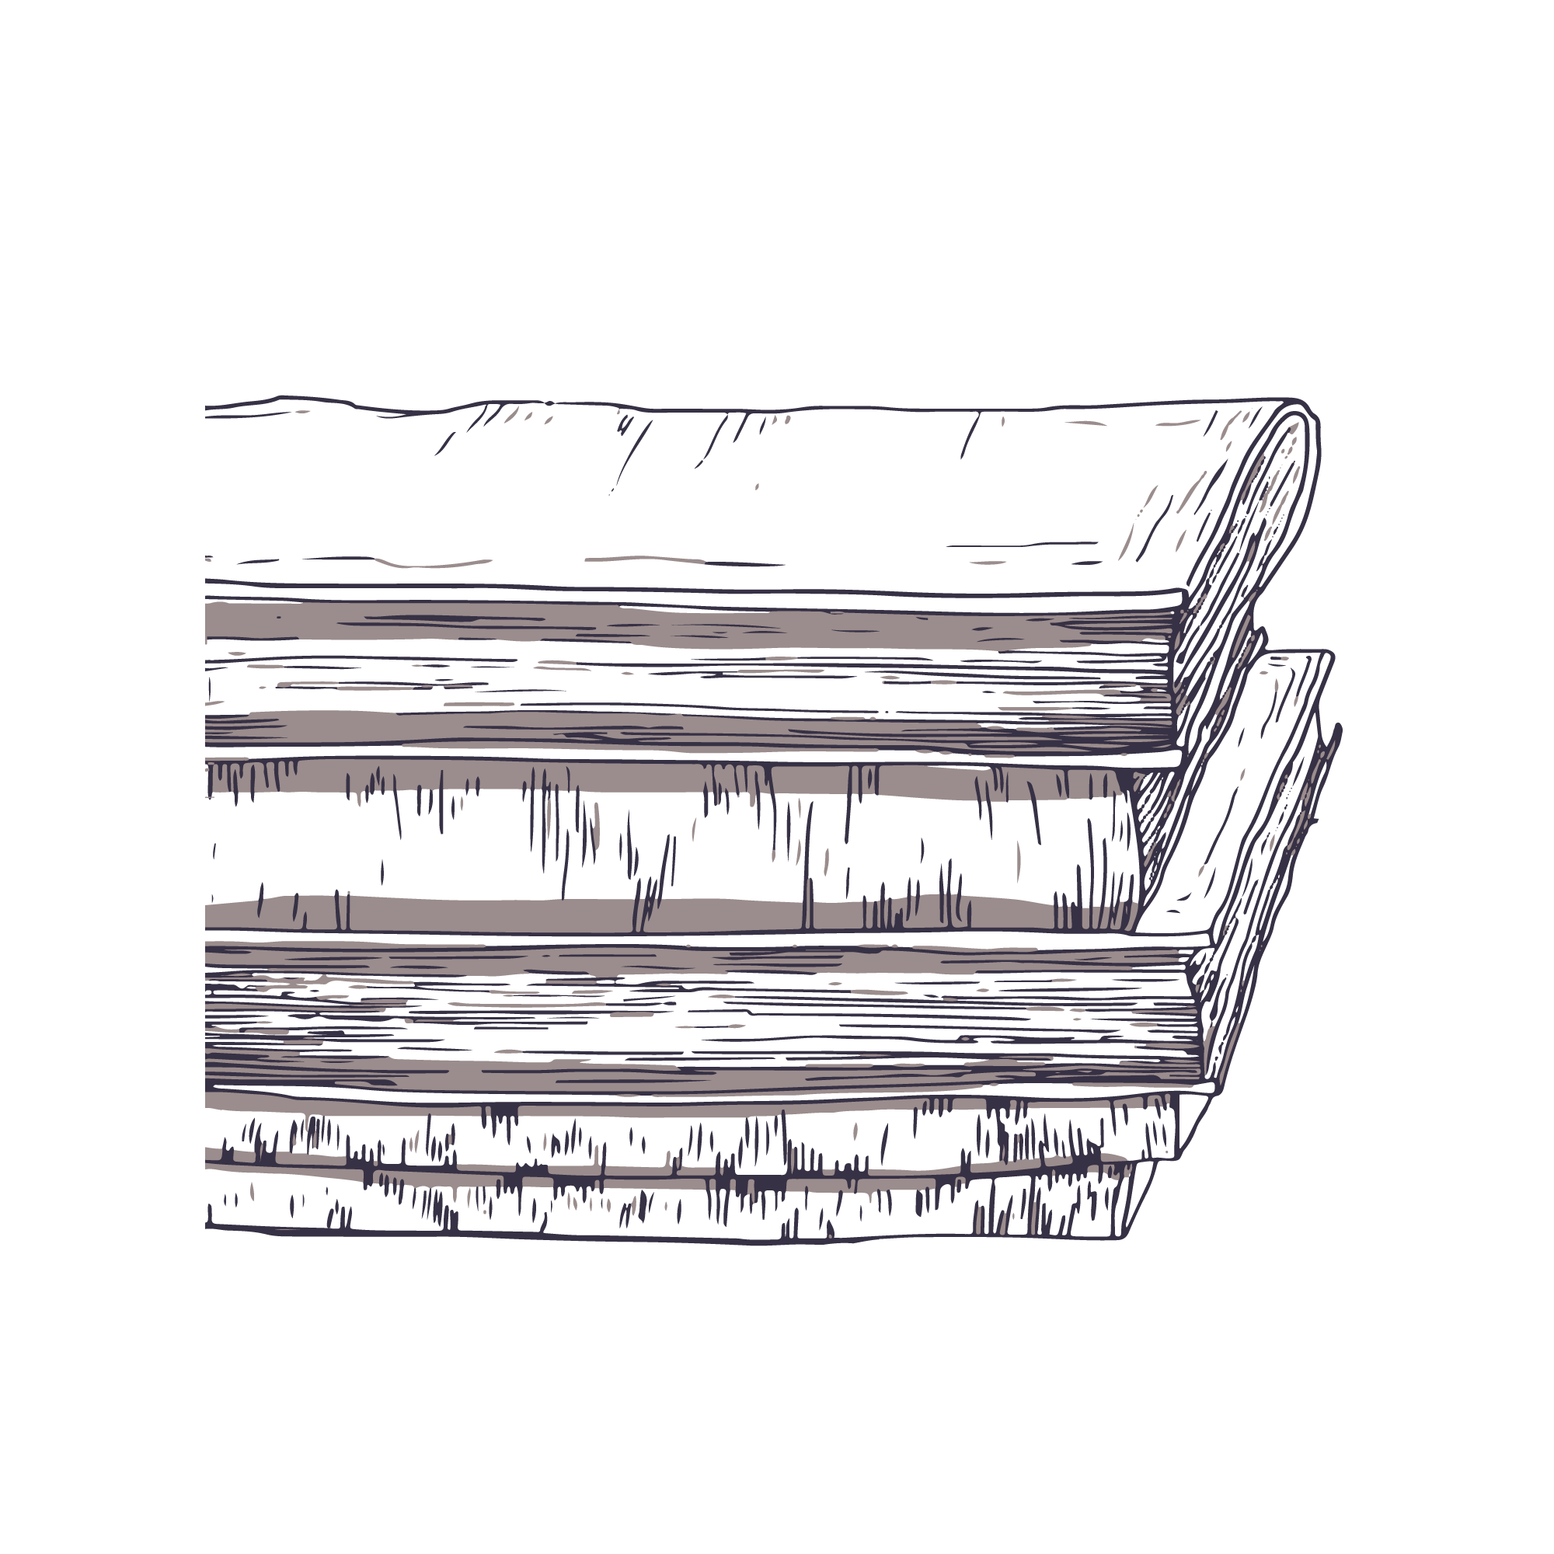
—Someone Famous
“This is a quote. Words full of wisdom that someone important said and can make the reader get inspired”

Slide 7
9h 55m 23s
333,000
386,000 km
Jupiter's rotation period
The Sun’s mass compared to Earth’s
Distance between Earth and the Moon

Slide 8
A picture always reinforces the concept
Images reveal large amounts of data, so remember: use an image instead of a long text. Your audience will appreciate it

Slide 9
Current situation & problems statement
Problems
Current situation
01
02
Jupiter is a gas giant and the biggest planet in the Solar System. It's the fourth-brightest object in the night sky. It was named after the Roman god of the skies and lightning
Earth
Mars
Earth is the third planet from the Sun and has life
Despite being red, Mars is actually a very cold place

Slide 10
Hypotheses
01
Hypothesis 1
Mercury is the closest planet to the Sun and the smallest one in the Solar System]
02
Hypothesis 2
Venus has a beautiful name and is the second planet from the Sun. It’s terribly hot

Slide 11
Study objectives
Mercury
Venus
Mars
Mercury is a very small planet
Venus has a beautiful name
Mars is actually a cold place

Slide 12
Reviewing concepts is a good idea
Mars
Venus
Neptune
Despite being red, it’s actually a cold place
Venus is the second planet from the Sun
Neptune is the farthest planet from the Sun
Mercury
Saturn
Jupiter
Mercury is the closest planet to the Sun
Saturn is a gas giant and has several rings
Jupiter is the biggest planet of them all

Slide 13
Literature review
AUTHOR. (YEAR). Title of the publication. Publisher
  Mercury is the closest planet to the Sun and the smallest one in the Solar System
AUTHOR. (YEAR). Title of the publication. Publisher
  Mars is full of iron oxide dust, which gives the planet its reddish cast
AUTHOR. (YEAR). Title of the publication. Publisher
  Jupiter is a gas giant and also is the biggest planet in the Solar System
AUTHOR. (YEAR). Title of the publication. Publisher
  Venus has a really beautiful name and also is the second planet from the Sun

Slide 14
Theoretical framework
Theoretical framework
Key terms
Relevant theories
Our framework
Mars is a really cold place
Jupiter it’s the biggest planet in the System
Venus has a beautiful name and is the second planet from the Sun. It’s very hot and has a extremely poisonous atmosphere
Mercury is a very small planet

Slide 15
Schedule
Task | Description |  | J | F | M | A | M | J | Date | Status
Task 1 | Mars is a cold planet |  | x | x | x |  |  |  | Jan 1 - Mar 15 | Completed
Task 2 | We all live on Earth |  |  | x | x | x |  |  | Feb 1 - Apr 30 | In progress
Task 3 | Venus is a hot planet |  |  |  | x | x |  |  | Mar 15 - Apr 30 | Delayed
Task 4 | Jupiter is a big planet |  |  |  |  | x | x |  | Apr 3 - May 20 | Delayed
Task 5 | Saturn is the ringed planet |  |  |  |  |  |  | x | Jun 15 - Jun 30 | In progress

Slide 16
Methodology
Mars
Venus
Despite being red, Mars is actually a really cold place
Venus has a beautiful name and is the second planet from the Sun
Mercury
Jupiter
Mercury is the closest planet to the Sun and the smallest one
Jupiter is a gas giant and the biggest planet in the Solar System

Slide 17
Analysis & development
Phase 01
Phase 02
Mercury is the closest planet to the Sun and the smallest one in the Solar System—it’s a bit larger than the Moon
Jupiter is a gas giant, the biggest planet in the Solar System and it also has around eight moons
Venus has a beautiful name and is the second planet from the Sun. It’s terribly hot—even hotter than Mercury
Saturn is a gas giant and has several rings. This planet is composed mostly of hydrogen and helium

Slide 18
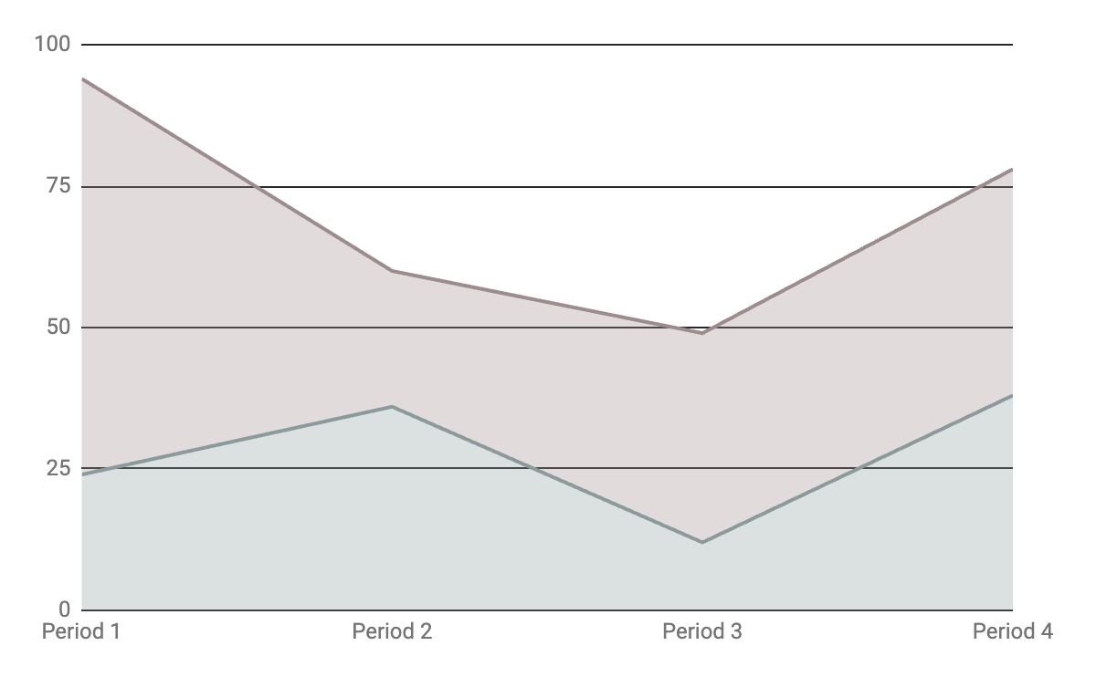
Analysis & development
100,200
New cases
Saturn
Earth is the planet with life
Mars
Follow the link in the graph to modify its data and then paste the new one here. For more info, click here
Despite being red, it’s a cold place

Slide 19
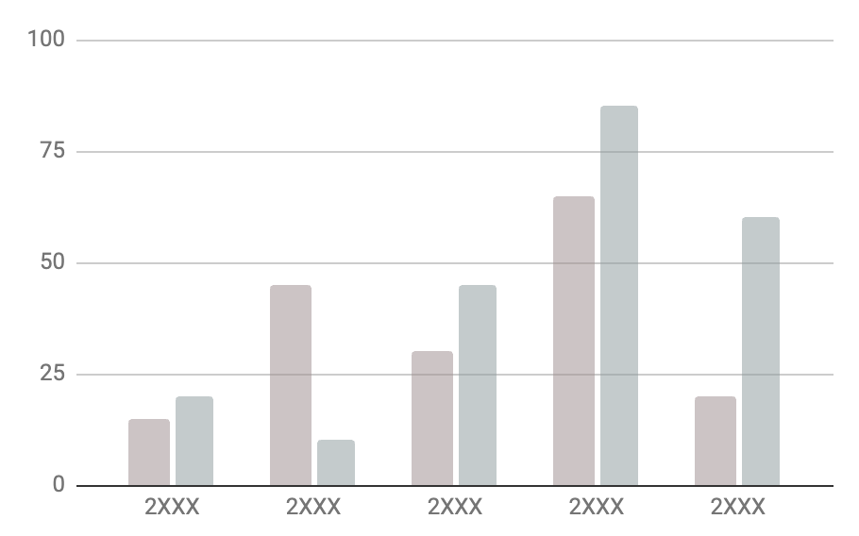
Analysis of the results
Venus
Mercury
Venus has a beautiful name
Mercury is quite a small planet
Follow the link in the graph to modify its data and then paste the new one here. For more info, click here

Slide 20
This is a map
Venus
Venus has a beautiful name
Mercury
Mercury is very small
Mars
Mars is made of basalt

Slide 21
Discussion
Mars & Earth
Discussion 1
Despite being red, Mars is actually a cold place. It's full of iron oxide dust, which gives the planet its reddish cast.
Ceres is located in the main asteroid belt
The Moon is Earth’s natural satellite
Neptune is very far away from us
Mercury is the closest planet to the Sun and the smallest one in the Solar System—it’s only a bit larger than the Moon
Discussion 2
Venus has a beautiful name and is the second planet from the Sun. It’s terribly hot—even hotter than Mercury

Slide 22
Conclusions
Mars
Venus
Despite being red, Mars is actually a cold place
Venus has a very beautiful name and has a toxic atmosphere
Mercury
Neptune
Mercury is the closest planet to the Sun and the smallest one
Neptune is the fourth-largest planet by diameter

Slide 23
Bibliographical references
Surname, A. (YEAR). Name of the source. Publisher
Surname, A. (YEAR). Name of the source. Publisher
Surname, A. (YEAR). Name of the source. Publisher
Surname, A. (YEAR). Name of the source. Publisher
Surname, A. (YEAR). Name of the source. Publisher
Surname, A. (YEAR). Name of the source. Publisher
Surname, A. (YEAR). Name of the source. Publisher
Surname, A. (YEAR). Name of the source. Publisher
Surname, A. (YEAR). Name of the source. Publisher
Surname, A. (YEAR). Name of the source. Publisher

Slide 24
Thanks!
Do you have any questions?
youremail@freepik.com
+34 654 321 432
yourwebsite.com
Please keep this slide for attribution

